Slide 1


Distributed Point-of-Sale System
A scalable retail database solution for multi-branch operations

Slide 2
Group 09
Arham Sharif EB21102022
Subhan Ali EB22210006125
Bisma Imran EB22210006029
Course: Distributed Database Systems (BSCS 606) Instructor: Dr. Taha Shabbir
Department: Department of Computer Science (UBIT)
Institute: University of Karachi

Slide 3

The Problem
Single Point of Failure
High Latency
Central database outage halts all store operations instantly.
Cashiers wait for queries traveling to distant central servers.
Network Dependency
System performance entirely dependent on network stability.

Slide 4




The Solution: Distributed Architecture
A hybrid approach combining centralized master data with localized transactional operations across Karachi and Lahore stores.
Central Database
Master data: Products, Categories, Cities
Store Databases
Local operations: Orders, Inventory, Payments
Replication
Trigger-based sync of customer and store data

Slide 5
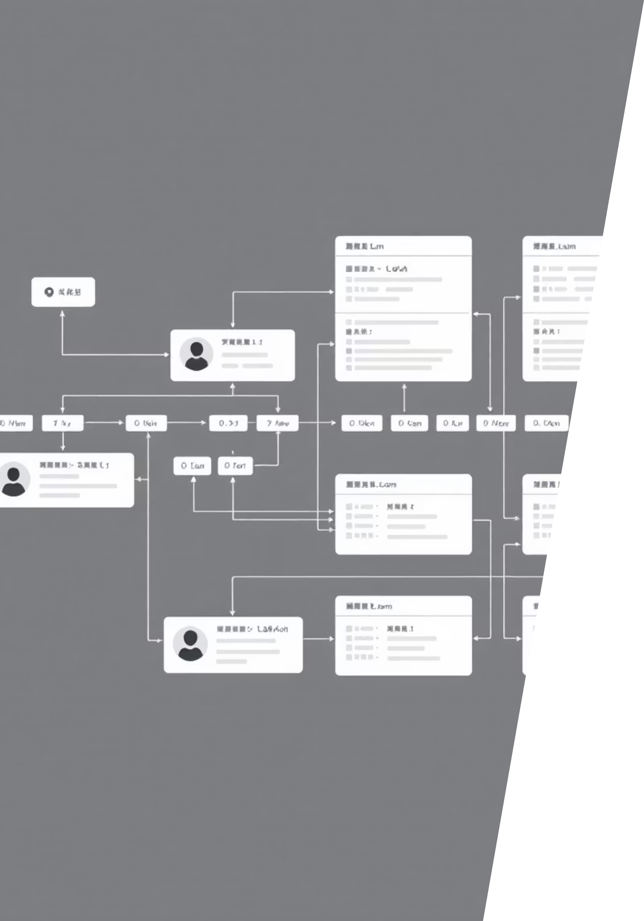
Database Design: Core Entities
Central Database (pos_central)
Store Databases (karachi_db, lahore_db)
Products & Categories
Orders & Order Items
Cities & Stores
Payments
Customers (master)
Inventory
Order Mapping
Replicated Customers
Replication Logs
Replicated Stores

Slide 6
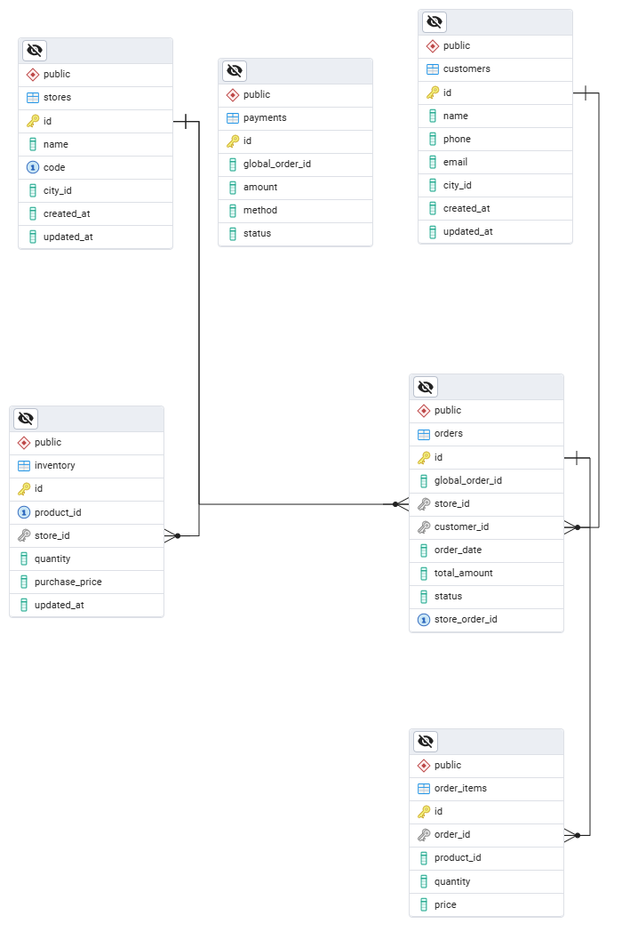

pos_central
stores

Slide 7
Fragmentation Strategy
Horizontal Fragmentation
Local Decentralization
Customers and Stores split by city_id across databases.
Orders, Inventory, Payments maintained exclusively at store level.
Table
Type
Fragment Key
Location
Customers
Horizontal
city_id
Central → Store DBs
Orders
Local
Store-level
Store DB only
Inventory
Local
Store-level
Store DB only

Slide 8

Replication & Concurrency Control
01
02
03
Trigger-Based Replication
Asynchronous Sync
Pessimistic Locking
AFTER INSERT/UPDATE triggers on Customers and Stores invoke replication functions using dblink.
Data propagates to appropriate store database based on city_id.
FOR UPDATE locks prevent simultaneous inventory modifications during order processing.

Slide 9
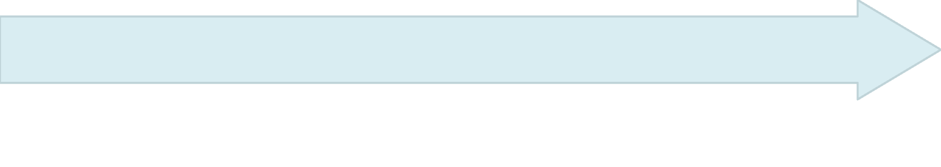

Implementation: Order Processing
ProcessOrder stored procedure handles complex transactions with inventory locking and distributed mapping.
Calculate Total
Sum all items: quantity × price
Lock Inventory
Exclusive locks prevent concurrent modifications
Map Globally
Insert Records
UUID sent to central Order_Mapping table
Orders, items, payments created locally

Slide 10
System Results: Live Data
Successfully processed orders with automatic inventory updates and payment tracking across distributed stores.
Order UUID
Order Details
Inventory Updates
Global transaction identifier
Store-level transaction records
Real-time stock adjustments

Slide 11
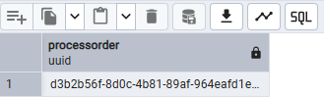
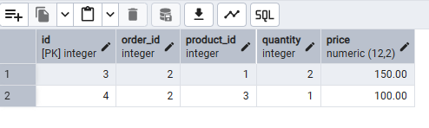
Order
UUID
Order Items
Inventory
Payment
Order Mapping

Slide 12

Fault Tolerance & Security
Replication Logging
Role-Based Access
Backup & Recovery
Every sync attempt tracked; failed replications logged for retry.
dblink_user limited to SELECT, INSERT, UPDATE—no DROP/DELETE.
pg_dump backups with pg_restore recovery for disaster scenarios.

Slide 13

Conclusion & Future Enhancements
Achievements
Future Roadmap
Eliminated single point of failure
Dynamic scaling for new cities
PostgreSQL Logical Replication
Reduced latency via local processing
ETL-based data warehouse
Ensured data consistency
Advanced analytics integration
Implemented fault tolerance

Slide 14
THANK YOU!

